Slide 1
Chongqing University of Technology
ATAI
Advanced Technique of Artificial Intelligence
Chongqing University of Technology
RecGURU: Adversarial Learning of Generalized User
Representations for Cross-Domain Recommendation（WSDM_2022）
Huanming Zhang
Platform and Content Group,Tencent
Shenzhen, China
Chenglin Li
University of Alberta
Edmonton, AB, Canada
Mingjun Zhao
University of Alberta
Edmonton, AB, Canada
Chenyun Yu
Sun Yat-sen University
Shenzhen, China
Lei Cheng
Platform and Content Group,Tencent
Shenzhen, China
Guoqiang Shu
Platform and Content Group,Tencent
Shenzhen, China
Beibei Kong
Platform and Content Group,Tencent
Shenzhen, China
Di Niu
University of Alberta
Edmonton, AB, Canada
2021.12.7 • ChongQing
Reported by Lele Duan
Code:https://github.com/Chain123/RecGURU

Slide 2
Chongqing University of Technology
ATAI
Advanced Technique of Artificial Intelligence
Chongqing University of Technology
1.Background
2.Method
3.Experiments

Slide 3
Background
Task: Alleviating the data sparsity issue in sequential recommender systems.
Transfer learning.
Mapping functions : Based on data of the overlapped users, mapping user representations from one domain to another.
RecGURU:
Generalized User Representation Unit (GURU).
Pre-train the autoencoder.
Adversarial learning phase.
Cross-Domain Sequential Recommendation (CDSRec) unit.

Slide 4
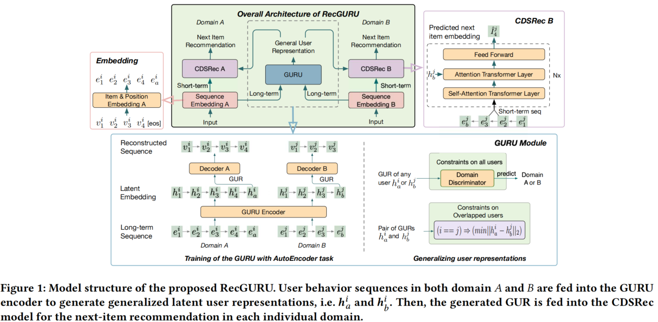
Method
Over view

Slide 5
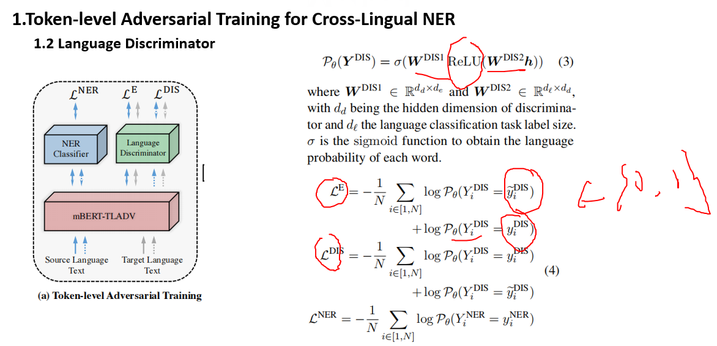
2021_ACL_Effectively Leveraging Unlabeled Data via Adversarial.pptx

Slide 6
Method
Problem Definition
Sequential recommendation:
For each user
Non-overlapped users
Cross-domain scenarios:
Overlapped users
For next item recommendation in domain ，
given the behavior sequences and
in domains and :

Slide 7
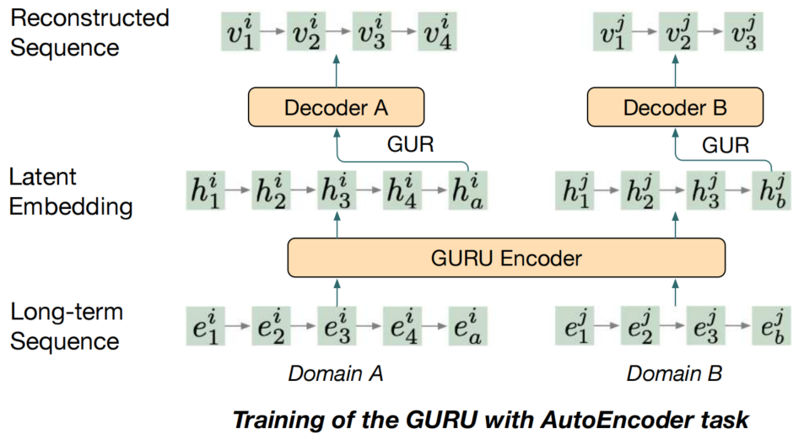
Method
Pre-train the autoencoder

Slide 8
Method
Adversarial learning (Generalizing User Representation Across Domains)

Slide 9
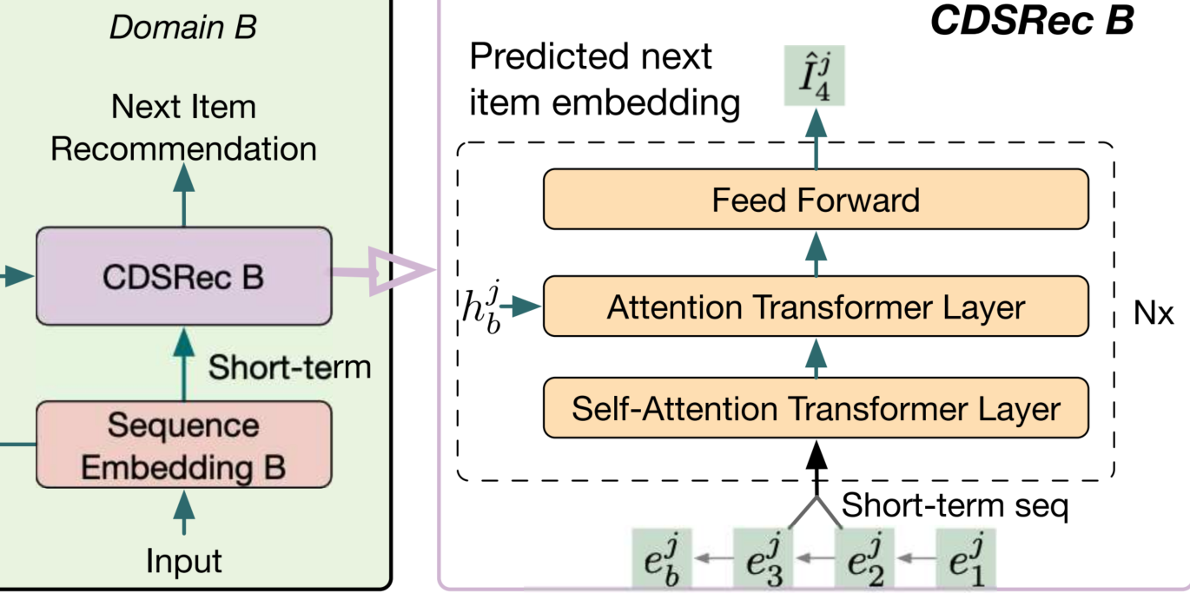
Method
Cross-domain Sequential Recommendation
Preference scores:
Bayesian Personalized Ranking (BPR) loss:

Slide 10
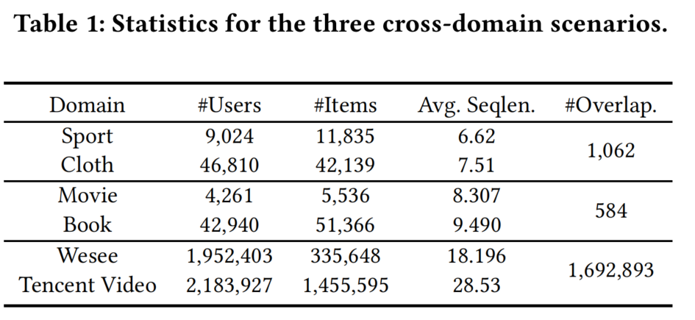
Experiment

Slide 11
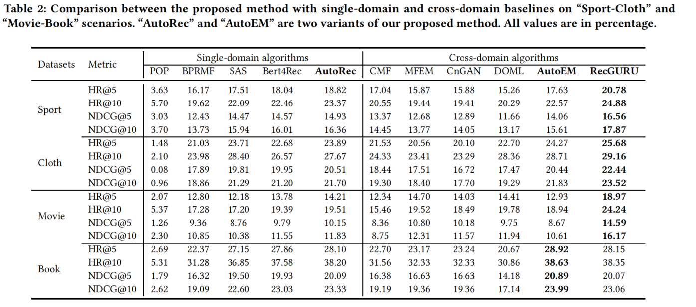
Experiment

Slide 12
Experiment

Slide 13
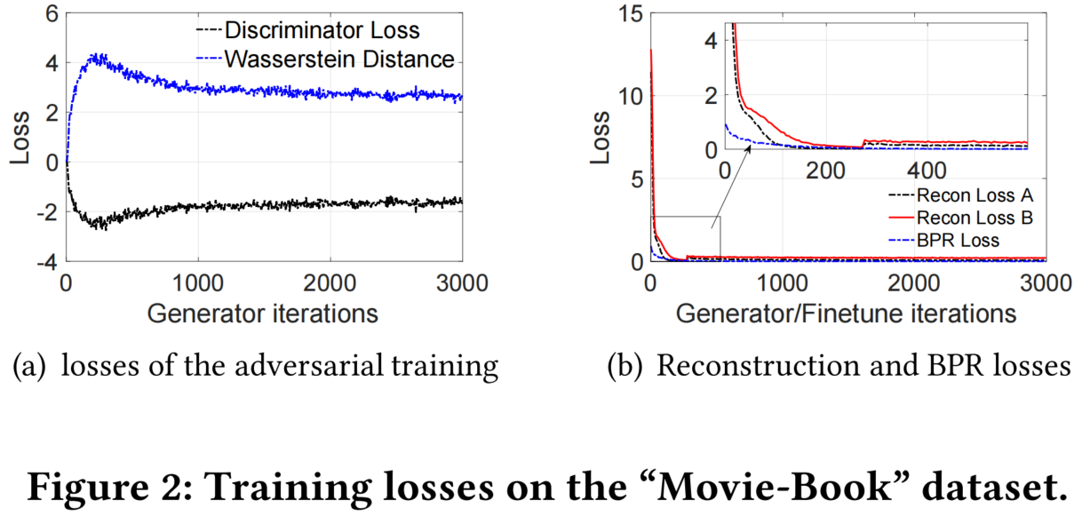
Experiment

Slide 14
Chongqing University of Technology
ATAI
Advanced Technique of Artificial Intelligence
Chongqing University of Technology
Thank you!

